Slide 1

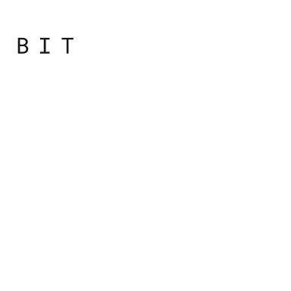
Programming
Principles
with JavaScript

Slide 2

Overview
JavaScript. History. Lexical Structure
Types, Values and Variables
Numbers and Strings

Slide 3
JavaScript
Introduction and History

Slide 4
Web Development Today
HTML for content, CSS for presentation, and JavaScript for behavior.
JavaScript is the glue that makes everything work together so that we can build rich web applications.

Slide 5
Web Development Today
JavaScript can be used for more than just the Web.
JavaScript programs run inside a host environment.
A web browser is the most common environment, but it's not the only one.

Slide 6
Safe to say that JavaScript is everywhere

Slide 7
A Bit of History
Webmasters wanted to create richer websites (for example form validation)
Two options came up:
Java applets
LiveScript
In 1995 and later, Netscape 2.0 browser included LiveScript under the name of JavaScript

Slide 8
A Bit of History
The ability to use short code snippets embedded in HTML documents and alter static elements of a web page was embraced by the webmaster

Slide 9
A Bit of History
Microsoft shipped Internet Explorer (IE) 3.0 with JScript
A reverse engineered version of JavaScript plus some IE-specific features

Slide 10
A Bit of History
Netscape and Microsoft were competing for a market share
led to many inconsistencies
development was a pain
in other browsers script simply fails for no apparent reason

Slide 11
A Bit of History
Need to standardize implementations of the language
ECMAScript
was born

Slide 12
A Bit of History
ECMA (European Computer Manufacturers Association) created the standard called ECMA-262, that describes the core parts of the JavaScript programming language without the browser and web page-specific features

Slide 13
3 pieces of JavaScript
ECMAScript — the core language
variables, functions, loops...
independent of the browser
this language can be used in many other environments

Slide 14
3 pieces of JavaScript
Document Object Model (DOM)
provides ways to work with HTML and XML documents.
World Wide Web Consortium (W3C) standardized as a language-independent (no longer tied to JavaScript) way to manipulate structured documents.

Slide 15
3 pieces of JavaScript
Browser Object Model (BOM)
set of objects related to the browser environment
was not part of any standard until HTML5 started standardizing some of the common objects that exist across browsers

Slide 16
JavaScript today is used to:
Create rich and powerful web applications (the kind of applications that run inside the web browser)
Write server-side code using Node.js
Make mobile applications
Write command-line tools and scripts that automate tasks
Write extensions and plugins
Create cross operating system desktop applications

Slide 17
ECMAScript 5
Revision 5 of ECMAScript is the one you can take for granted to be implemented in all browsers and environments today (aka ECMAScript 5 or ES5)
Was officially accepted in December 2009

Slide 18
Lexical Structure

Slide 19
Lexical structure
A set of elementary rules that specifies how you write programs in that language
Lowest-level syntax of a language
Notes:
Specifies such things as what variable names look like, the delimiter characters for comments, and how one program statement is separated from the next.

Slide 20
Character Set
JavaScript programs are written using the Unicode character set
superset of ASCII and Latin-1
supports virtually every written language currently used on the planet

Slide 21
Case Sensitivity
JavaScript is a case-sensitive language
while keyword must be typed “while”, not “While”
online, Online, OnLine, and ONLINE
are four distinct variable names
HTML is not case-sensitive

Slide 22
Whitespace, Line Breaks
JavaScript ignores spaces that appear between tokens in programs.
For the most part, JavaScript also ignores line breaks
Use spaces and newlines freely in programs
Format and indent your programs in a consistent way that makes the code easy to read and understand

Slide 23
Identifiers and Reserved Words
An identifier is simply a name that we add in code
Identifiers are used to name variables and functions
They provide labels

Slide 24
Identifiers and Reserved Words
A JavaScript identifier must begin with a letter, an underscore (_), or a dollar sign ($)
Digits are not allowed as the first character so that JavaScript can easily distinguish identifiers from numbers
It is common to use only ASCII letters and digits in identifiers

Slide 25
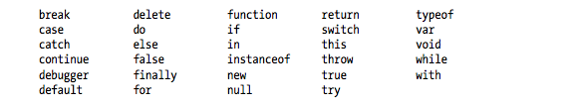
Identifiers and Reserved Words
JavaScript reserves a number of identifiers as the keywords of the language
You cannot use these words as identifiers in your programs

Slide 26
Identifiers and Reserved Words
You cannot use these words as identifiers in your programs

Slide 27
Optional Semicolons
Like many programming languages, JavaScript uses the semicolon (;) to separate statements from each other
var myName = “JS”; console.log(myName)
console.log(“First statement”)
console.log(“Second statement”)
You can omit the semicolon between two statements if those statements are written in separate lines

Slide 28
Optional Semicolons
Many JavaScript programmers use semicolons to explicitly mark the ends of statements, even they are not required
It’s recommended to use semicolons to finish statements in JS

